Slide 1
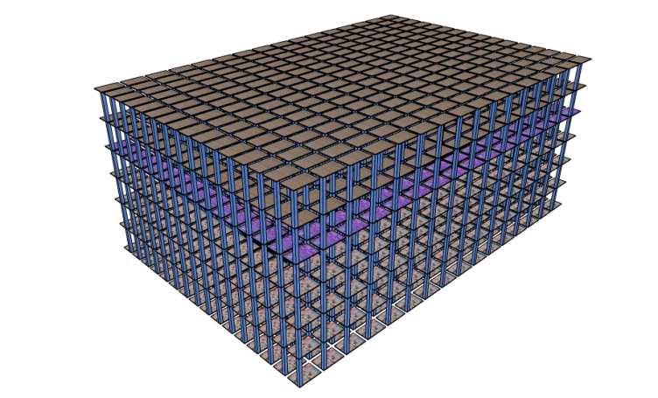
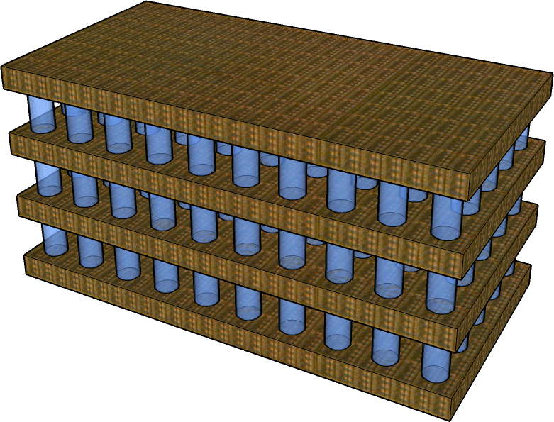
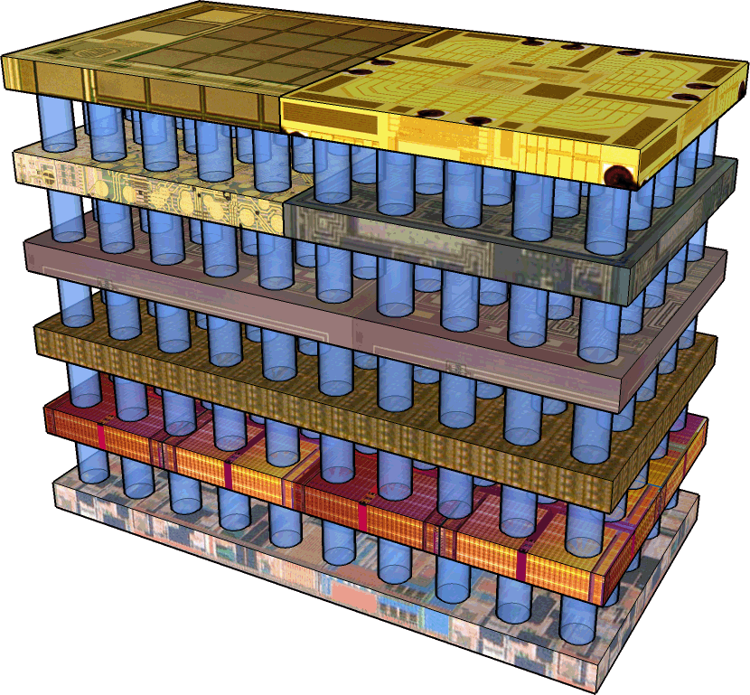
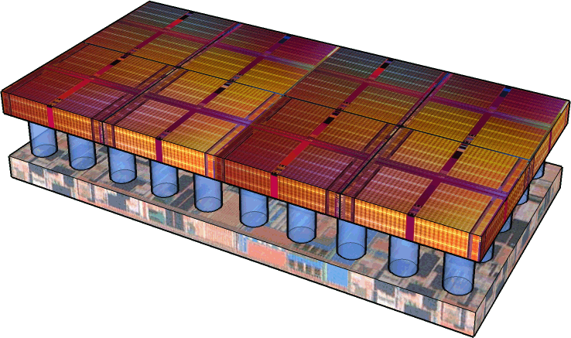
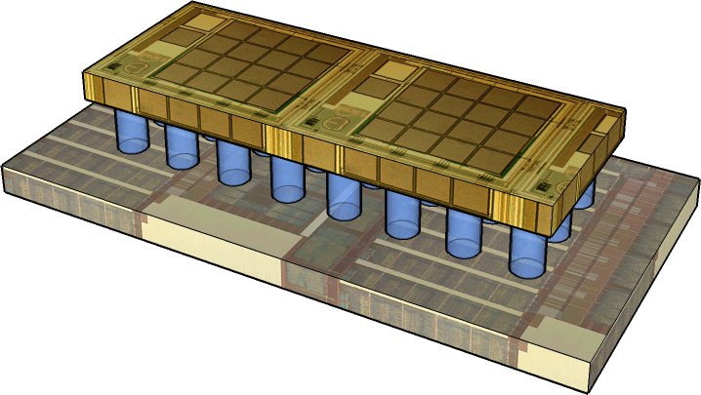
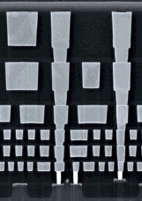
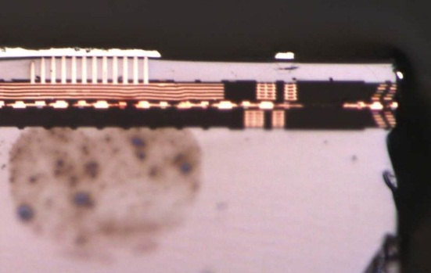


Symbiotic Scheduling for Shared Caches in Multi-Core Systems Using Memory Footprint Signature
∗ Mrinmoy Ghosh
∗ Ripal Nathuji
Min Lee
Karsten Schwan
Hsien-Hsin S. Lee
ARM ∗ Microsoft Research ∗ Georgia Tech

Slide 2
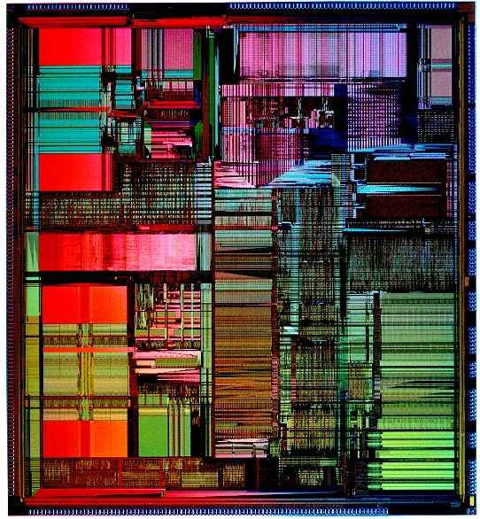

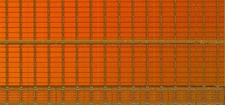
Cache Interference in “Concurrent Processes”
P2
Core A
Core B
P1
L1 Cache
L1 Cache
Line Hit !!!
L2 Cache
Conflict !!!
P1 $ Line
P2 $ Line

Slide 3
Cache Interference Effect (Concurrent Processes)
Maximum performance degradation less than 10%
Notes:
Current trend of increasing transistors on-chip manifests in two ways: larger caches as well as more number of levels of caches on the chip. Hence, memory hierarchy increasingly influences the performance of the system. The memory hierarchy being a significant portion of the chip area makes it a major contributor to the power as well. For example, the larger cache area may dissipate a significant amount of leakage power. This increased consumption is not only a major concern in embedded systems, where battery life and heat dissipation are important design concerns but also in desktop systems and servers due to their increased cooling costs. In my work, I focus on microarchitectural techniques that reduce the energy consumption of the memory hierarchy and increase its efficiency.

Slide 4
Cache Interference in “Shared Cache Multi-Core”
Core A
Core B
P1
P2
L1 Cache
L1 Cache
Conflict !!!
L2 Cache
P2 $ Line
P1 $ Line

Slide 5
Cache Interference Effect (Shared Cache Multi-Core)
Performance degraded by as much as 65%
Intelligent Process Management Needed !!
Notes:
Current trend of increasing transistors on-chip manifests in two ways: larger caches as well as more number of levels of caches on the chip. Hence, memory hierarchy increasingly influences the performance of the system. The memory hierarchy being a significant portion of the chip area makes it a major contributor to the power as well. For example, the larger cache area may dissipate a significant amount of leakage power. This increased consumption is not only a major concern in embedded systems, where battery life and heat dissipation are important design concerns but also in desktop systems and servers due to their increased cooling costs. In my work, I focus on microarchitectural techniques that reduce the energy consumption of the memory hierarchy and increase its efficiency.

Slide 6
Process (In-)Compatibility in Multi-Cores
Problem
Processes in different cores can be incompatible
Shared resource contention
Observation
Less contention of incompatible processes when running on the same core
Insight:
Process incompatibility severely affects performance
Compatibility-based scheduling increases throughput

Slide 7

Ideas
Use Counting Bloom Filter to record memory access signature
Compatibility test using signature

Slide 8
Insertion: Counting Bloom Filter
1
N-to-m
Hash Func X
N-bit Data Address A
N-to-m
Hash Func Y
1
Presence
Bit
Counter

Slide 9
Insertion: Counting Bloom Filter
1
1
N-to-m
Hash Func X
N-bit Data Address B
N-to-m
Hash Func Y
2
1
Presence
Bit
Counter

Slide 10
Deletion: Counting Bloom Filter
1
1
N-to-m
Hash Func X
Data Address A
Was Evicted
N-to-m
Hash Func Y
1
2
Presence
Bit
Counter

Slide 11
Query: Counting Bloom Filter
1
0
N-to-m
Hash Func X
Data Address A
??
N-to-m
Hash Func Y
2
1
Data Not Present !!!
Presence
Bit
Counter

Slide 12
Bloom Filter Signatures vs. Cache Footprint
Strong Correlation !!!
Notes:
Current trend of increasing transistors on-chip manifests in two ways: larger caches as well as more number of levels of caches on the chip. Hence, memory hierarchy increasingly influences the performance of the system. The memory hierarchy being a significant portion of the chip area makes it a major contributor to the power as well. For example, the larger cache area may dissipate a significant amount of leakage power. This increased consumption is not only a major concern in embedded systems, where battery life and heat dissipation are important design concerns but also in desktop systems and servers due to their increased cooling costs. In my work, I focus on microarchitectural techniques that reduce the energy consumption of the memory hierarchy and increase its efficiency.

Slide 13
Architectural Support

Slide 14
Bloom Filter Signature Multi-Core Architecture
Core A
Core B
L1 Cache
L1 Cache
Last Filter
Last Filter
Core Filter
Core Filter
L2 Cache
Bloom Filter Counters

Slide 15
Bloom Filter Signature Multi-Core Architecture
P3
Core A
Core B
P1
P2
L1 Cache
L1 Cache
Last Filter
Last Filter
Core Filter
Core Filter
L2 Cache
Bloom Filter Counters

Slide 16
Metric for Execution State
Last Filter
Core Filter
RBV (Running Bit Vector)
+
Occupancy Weight
(i.e., # of 1s)

Slide 17

Interference Metric (Complement of Symbiosis)
Process Pool
(Processes waiting to be scheduled)
Proc1 RBV
Core Filter
Proc0
Proc1
Proc2
+
Symbiosis = 5
Proc*
Proc**
+
Interference Metric = N - 5

Slide 18
Process-to-Core
Mapping Algorithms
A1: Use Occupancy Weight
A2: Use Interference Graph
A3: Use Weighted Interference Graph

Slide 19
A1: Weight Sorted Algorithm
Sort all processes according to occupancy weight
Processes form groups using sorted weight
# of processes in a group = ⎡Processes/Cores⎤
Map processes to cores based on sorting results
P0
100
P4
99
P2
70
P5
65
P6
43
P3
20
P1
15
Core A
Core B
Core C
Core D
L1 Cache
L1 Cache
L1 Cache
L1 Cache

Slide 20
A2: Interference Graph Algorithm
Form interference graph using interference metric
Find MAX-CUT of the graph
P0
C_{A}=20
C_{B}=30
P1
C_{A}=10
C_{B}=45
P2
C_{A}=40
C_{B}=25
P3
C_{A}=15
C_{B}=50
Was in C_{A}
Was in C_{B}
30
P0
(A)
P2
(B)
40
Interference Graph
P1
(A)
P3
(B)

Slide 21
A2: Interference Graph Algorithm
Form interference graph using interference metric
Find MAX-CUT of the graph
P0
C_{A}=20
C_{B}=30
P1
C_{A}=10
C_{B}=45
P2
C_{A}=40
C_{B}=25
P3
C_{A}=15
C_{B}=50
Was in C_{A}
Was in C_{B}
P0
(A)
70
P2
(B)
Interference Graph
P1
(A)
P3
(B)

Slide 22
A2: Interference Graph Algorithm
Form interference graph using interference metric
Find MAX-CUT of the graph
P0
C_{A}=20
C_{B}=30
P1
C_{A}=10
C_{B}=45
P2
C_{A}=40
C_{B}=25
P3
C_{A}=15
C_{B}=50
Was in C_{A}
Was in C_{B}
P0
(A)
70
P2
(B)
45
30
75
Interference Graph
P1
(A)
85
P3
(B)
60

Slide 23
A2: Interference Graph Algorithm
Form interference graph using interference metric
Find MAX-CUT of the graph
P0
(A)
70
P2
(B)
45
30
75
Interference Graph
P1
(A)
85
P3
(B)
60
P1
(A)
85
P2
(B)
P0
(A)
45
P3
(B)

Slide 24
A3: Weighted Interference Graph Algorithm
To address high interference issues
Weight the edges of the interference graph
The rest are the same as A2
P0
OW=90
C_{A}=20
C_{B}=30
P1
OW=85
C_{A}=10
C_{B}=45
P2
OW=50
C_{A}=40
C_{B}=25
P3
OW=100
C_{A}=15
C_{B}=50
Was in C_{A}
Was in C_{B}
90*30
P0
(A)
P2
(B)
50*40
Interference Graph
P1
(A)
P3
(B)

Slide 25
Performance Evaluation

Slide 26

Evaluation Methodology
P1
P2
P3
PN
P1
P2
P3
PN
Intel Core 2
Fedora Linux
“magic”
interface
Native x86 Run
Simics x86
P1
P2
PN
Linux
Linux
Linux
Xen Hypervisor
Intel Core 2
Gather Footprint
in Emulator
Process-to-Core
Mapping
VM Run

Slide 27
Performance Results
Maximum performance improvement of up to 54%
Average performance improvement of up to 23%

Slide 28
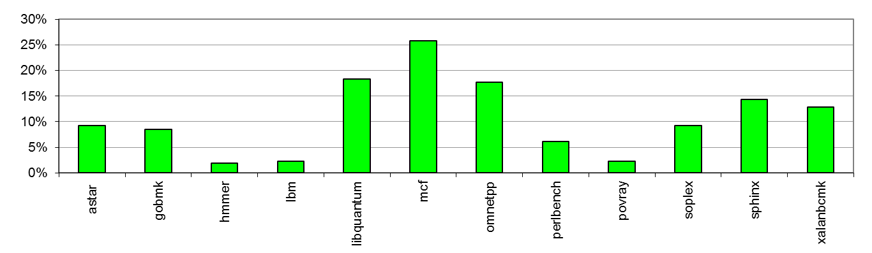
Performance of Virtualized Systems
Maximum performance improvement of up to 26%
Average performance improvement of up to 9.5%

Slide 29
Performance Sensitivity of 3 Algorithms
Weighted Interference Graph has the best performance

Slide 30
Conclusion
Shared Resource (e.g., LLC) Management is Critical
Capturing Cache Reference Behavior for Processes
Measured Speedup of 22% (up to 54%) on Intel Core 2
Process Scheduling using Compatibility in Multi-Core
Symbiotic Scheduling with Bloom Filter Signature

Slide 31


That’s All, Folks!
Georgia Tech
ECE MARS Lab
http://arch.ece.gatech.edu

